Slide 1


SQL Server Performance Troubleshooting for the DBA
Sat May 26, 2012
Jorge Sánchez SQL Server Consultant, Rock Solid Technologies jsanchez@rocksolid.com
Work: (787) 235-0773, Personal: (787) 487-2977
http://rocksolid.com
http://www.linkedin.com/in/jorgesanchezpr

Slide 2


Complete the Evaluation Form to Win!
Win a book – just for submitting your completed form. Each session evaluation form represents a chance to win ☺.
Pick up your evaluation form:
In each presentation room
Drop off your completed form:
Near the exit of each presentation room
www.facebook.com/prpass

Slide 3
Profile
Mr. Jorge Sánchez brings 25 years of experience in the IT industry, currently working for Rock Solid Technologies as SQL Server Consultant.
Previously, Mr. Sanchez worked 8 years in Microsoft Puerto Rico as SQL Server Regional Specialist for Caribbean and Central America with direct focus in Puerto Rico, Costa Rica, Dominican Republic, and Trinidad.
Before that, he worked 14 years as Senior Consultant, Developer, and SQL Server Certified Instructor within the Microsoft Partners Ecosystem.

Slide 4
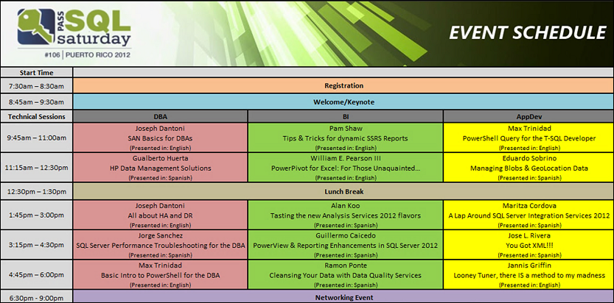

Slide 5
Methodology

Slide 6
Telecommunications
(Networking, Name Resolution, Authentication, SAN, …)
Telecommunications
Hardware & Storage
Hardware & Storage
(CPU, RAM, Storage, PCIe, HBA, NUMA, BIOS, Firmware, HyperThreading, …)
Virtualization
Virtualization
(Hosts, Guests per Host, Shared CPU Cores, Data Stores, LUNs per Disk, …)
Windows Server OS
SQL Server Engines
Windows Server OS
(Edition, Platform, Power Options, HBA Queue Depth, MultiPath I/O, Disk Volume Partitioning & Formatting, Firewall, NICs Configuration, Jobs, …)
Databases
Queries
SQL Server Engines
(Edition, Platform, Instance Configuration, Service Accounts & Permissions, tempdb, Failover Clustering, Database Mirroring, Replication, Filestream, Resource Governor, Startup Parameters, Automatic Jobs, …)
SQL Server Databases
(Indexes, Table Partitioning, Index Views, Triggers, Statistics, …)

Slide 7
Best Practices
Checklist

Slide 8
Installation & Configuration Best Practices for Performance
Server Role. Server should be a member server of a Microsoft Active Directory network, and dedicated only to SQL Server. Windows File, Print, and Domain Controller services should be left for other machines.
System Architecture. Use 64-bit architecture server.
32-Bit Systems. Include de /PAE parameter inside the boot.ini file on Windows Server 2003 on servers with more than 4GB RAM.
SQL Server Edition. Use the DEVELOPER edition on development and test servers. Use the ENTERPRISE edition on QA and Production servers.
CPU Cache. Use servers with CPUs that has L3 memory cache.
Whitepapers. Look for Low-Latency best practices configurations on server manufacturer’s websites.
BIOS. Disable CPU Hyper-Threading (or “Logical Processor”) at the BIOS level. Use Intel’s Processor ID utility to verify it.
BIOS. Disable CPU Turbo Mode (or Turbo Boost Optimization).
BIOS. Disable CPU C-States (or C-3, C6, etc.).
BIOS. Disable CPU C1E.
BIOS. Change Power Management to Maximum Performance.
BIOS. Disable QPI Power Management.
BIOS. Change Power Profile to Maximum Performance.
BIOS. Change Power Regulator to High Performance Mode.
RAM Modules. Validate with the server’s manufacturer low-latency recommendations on CPU and memory SIMMs combinations, as well as memory SIMMs location on multiple memory channels per processor.
RAM per CPU Core. For OLTP systems, use 2GB-4GB RAM per CPU Core.
RAM per CPU Socket in Fast Track v3 (Data Warehousing). For 2-CPU Socket use minimum of 96 GB RAM. For 4-CPU Socket use minimum of 128 GB RAM. For 8-CPU Socket use minimum of 256 GB RAM.
Processor Scheduling. Be sure that in Computer properties, Performance Options, the Processor Scheduling parameter is configured for “Background Services”.
Network Interface Cards. Have, at least, two network interface cards connected to two different networks in order to divide application load from administrative load.

Slide 9
Installation & Configuration Best Practices for Performance
Network Interface Cards. Configure each network interface adapter for “Maximize data throughput for network applications”.
Network Interface Cards. For OLAP systems (Data Warehouses and Cubes), Database Mirroring, Log Shipping, and Replication… evaluate using Jumbo Frames (9-Mbps) on all devices that interact with each other (switches, routers, and NICs).
Disk Volumes. Use Solid-State (SSD) disks or 15K disks.
Disk Volumes. Use RAID-10 (or RAID-1) arrays when possible. Use RAID-5 as last option. Never use RAID-0. RAID-5 is excellent for reading, but not best for writing (specially bad in random write). On direct-attached systems (DAS), if you need to balance performance and space between solid-state disks (SSD) and 15K disks (SAS), one strategy is to have solid-state disk at RAID-5 and 15k disks at RAID-10.
RAID Controller. In virtual disks, indicate cache configuration in Write Policy = Write-Through (instead of Write-Back). The objective is to acknowledge the operating system the completion of the transaction when is written to the storage system instead of the RAID controller’s cache. Otherwise, is a consistency risk if the controller’s battery is not working and energy goes down.
Fast Track v3 (DW) – Disks. For Windows operating system and SQL Server binary files, use a 2-Disk Spindles RAID-1 local disks array.
Disk Volumes. Assign separate virtual disks (ex. SAN LUNs) for SQL Server data, log, tempdb, backups.
Disk Host Bus Adapter (HBA). Insert the HBA adapter into the fastest PCI-E slot.
PCIe x4 v2.0 delivers up to 2GB/sec.
PCIe x4 v1.0 delivers up 1GB/sec.
PCIe x1 v2.0 delivers up to 500MB/sec.
PCIe x1 v1.0 delivers up to 250MB/sec.
Disk Host Bus Adapter (HBA). Configure the HBA’s Queue Depth parameter (in Windows Registry) with the value that reports the best performance on SQLIO tests (x86 and x64 only) or SQLIOSIM (x86, x64, and IA64).
Fast Track v3 (DW) – Disks. For data files (*.MDF, *.NDF) use multiple SAN/DAS storage enclosures that have multiple RAID-10 groups each one with at least 4-spindles, but dedicate one RAID-10 group on each storage enclosure for log files (*.LDF). In Fast Track v3 tempdb is mixed with user databases.
Disk Volumes. Have each operating system disk partitioned as one volume only. Don’t divide each disk into multiple logical volumes.

Slide 10
Installation & Configuration Best Practices for Performance
Disk Volumes. Partition each disk volume with Starting Offset of 1024K (1048576).
Disk Volumes. Do NOT use Windows NTFS File Compression.
Disk Volumes. Format disk volumes using NTFS. Do not use FAT or FAT32.
Disk Volumes. Use Windows Mount Point Volumes (folders) instead of drive letters in Failover Clusters.
Disk Volumes. Format each SQL Server disk volume (data, log, tempdb, backups) with Allocation Unit of 64KB, and do a quick format if volumes are SAN Logical Units (LUNs).
Disk Volumes. Ratio #1. Be sure that the division result of Disk Partition Offset (ex. 1024KB) ÷ RAID Controller Stripe Unit Size (ex. 64KB) = equals an integer value. NOTE: This specific ratio is critical to minimize disk misalignment.
Disk Volumes. Ratio #2. Be sure that the division result of RAID Controller Stripe Unit Size (ex. 64KB) ÷ Disk Partition Allocation Unit Size (ex. 64KB) = equals an integer value.
Fast Track v3 (DW) – Multi-path I/O (MPIO) to SAN. Install and Multi-Path I/O (MPIO), configure each disk volume to have multiple MPIO paths defined with, at least, one Active path, and consult SAN vendor prescribe documentations.
Disk Volumes. Assign a unique disc volume to the MS DTC log file. Also, before installing a SQL Server Failover Cluster, create a separate resource dedicated to MS DTC.
Windows Internal Services. Disable any Windows service not needed for SQL Server.
Windows Page File. Be sure that Windows paging is configure to use each operating system disk only. Do not include paging file on any of SQL Server disks.
Antivirus. The antivirus software should be configure to NOT scan SQL Server database, logs, tempdb, and backup folders (*.mdf, *.ldf, *.ndf, *.bak) .
SQL Server Engine Startup Flags for Fast Track v3 (Data Warehousing). Start the SQL Server Engine with the -E and -T1117 startup flags.
SQL Server Service Accounts. Assign a different Active Directory service account to each SQL Server service installed.
Service Account and Windows Special Rights. Assign the SQL Server service account the following Windows user right policies: 1) Lock pages in memory, and 2) Perform volume maintenance tasks.
Address Windows Extensions (AWE). If the SQL Server service account has the Lock pages in memory Windows user right, then enable the SQL instance AWE memory option. ( Note: AWE was removed from SQL Server 2012; use 64-bit! ).

Slide 11
Installation & Configuration Best Practices for Performance
Instance Maximum Server Memory. If exist only one (1) SQL Database Instance and no other SQL engines, then configure the instance’s Maximum Server Memory option with a value of 85% the global physical memory available.
Tempdb Data Files. Be sure that the tempdb database has the same amount of data files as CPU cores and with the same size.
Startup Parameter T1118. Evaluate the use of trace flag T1118 as a startup parameter for the RDBMS engine to minimize allocation contention in tempdb.
Maximum Degree of Parallelism (MAXDOP). For OLTP systems, configure the instance’s MAXDOP=1 or higher (up to 8) depending on the number of physical CPU chips. For OLAP systems, configure MAXDOP=0 (zero).
Maximum Worker Threads. Configure the instance’s Maximum Worker Threads = 0 (zero).
Boost SQL Server Priority. Configure the instance’s Boost SQL Server Priority=0 (zero).
Database Data and Log Default Locations. Configure the instance database default locations for data and log files.
Backup Files Default Location. Configure the instance backup location.
Backup Compression. In SQL Server 2008, enable the instance backup compression option.
Filegroups. Before creating any database object (tables, indexes, etc.), create a new default filegroup (NOT PRIMARY) for data.
Data and Log Files Initial Size. Pre-allocate data and log files sizes. This will helps to minimize disk block fragmentation and consuming time increasing file size stopping process until it ends.
Fast Track v3 (DW) – Compression. For Fact Tables use Page Compression. In the other hand, compression for Dimension tables should be considered on a case-by-case basis.
Fast Track v3 (DW) – Index Defragmentation. When defragmenting indexes, use ALTER INDEX [index_name] on [schema_name].[table_name] REBUILD (WITH MAXDOP = 1, SORT_IN_TEMPDB = TRUE) to improve performance and avoid filegroup fragmentation. Do not use the ALTER INDEX REORGANIZE statement. To defrag indexes specially on FACT TABLES from data warehouses, include DATA_COMPRESSION = PAGE.
Tools. Use the Microsoft SQL Server 2008 R2 Best Practices Analyzer (BPA) to determine if something was left or not configured vs. best practices.

Slide 12
Installation & Configuration Best Practices for Performance
Tools. Use Microsoft NT Testing TCP Tool (NTttcp) to determine networking actual throughput.
Tools. Use Microsoft SQLIO and Microsoft SQLIOSim to stress test storage and validate communication errors.
Tools. Use CPUID CPUz to determine processor information, specially at which speed is currently running.
Tools. Use Intel Processor Identification to determine processor information, specially if Hyperthreading is running.

Slide 13
Dedicated Administrator Connections (DAC)

Slide 14
Dedicated Administrator Connections (DAC)
To enabled DAC
To connect using DAC on Management Studio or SQLCMD:
Using SQLCMD:
exec sp_configure 'remote admin connections',1
Reconfigure with override
ADMIN:[server_name\instance_name]
C:\>sqlcmd -S admin:localhost\sqlserver2008 -E
1> select
2> (
3> (select cntr_value *1.0 from sys.dm_os_performance_counters
4> where ltrim(rtrim(counter_name)) = 'Buffer cache hit ratio')
5> /
6> (select cntr_value *1.0 from sys.dm_os_performance_counters
7> where ltrim(rtrim(counter_name)) = 'Buffer cache hit ratio base')
8> ) *100.0 as buffer_cache_hit_ratio
9> go
buffer_cache_hit_ratio
----------------------------------------
100.000000000000
(1 rows affected)
1>

Slide 15
Database Options

Slide 16
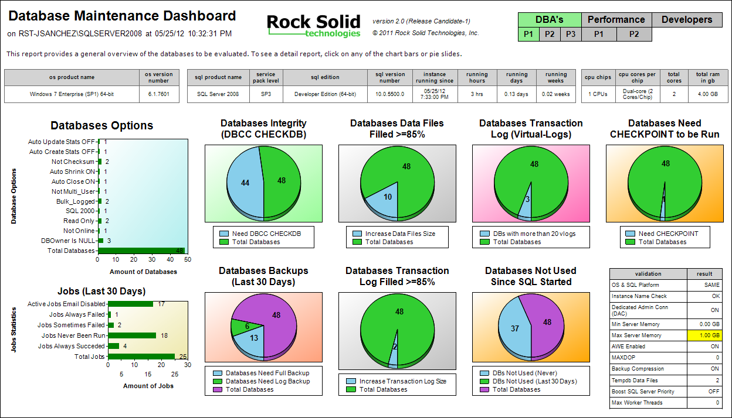

Slide 17
CPU Bottleneck

Slide 18
T-SQL for Determine if CPU Bottleneck
CPU Utilization on the Last 4-Hours
declare @ts_now bigint
select @ts_now = cpu_ticks / (cpu_ticks/ms_ticks) from sys.dm_os_sys_info
;with tbl
as
(
select
@@servername as SQLInstanceName
,dateadd(ms, -1 * (@ts_now - [timestamp]), GetDate()) as EventTime
,cast(SQLProcessUtilization as money) as SQLProcessUtilization_Pcnt
,cast((100 - SystemIdle - SQLProcessUtilization) as money) as OtherProcessUtilization_Pcnt
,cast(SystemIdle as money) as SystemIdle_Pcnt
from (
select
record.value('(./Record/@id)[1]', 'int') as record_id,
record.value('(./Record/SchedulerMonitorEvent/SystemHealth/SystemIdle)[1]', 'int') as SystemIdle,
record.value('(./Record/SchedulerMonitorEvent/SystemHealth/ProcessUtilization)[1]', 'int') as SQLProcessUtilization,
timestamp
from (
select timestamp, convert(xml, record) as record
from sys.dm_os_ring_buffers
where ring_buffer_type = N'RING_BUFFER_SCHEDULER_MONITOR'
and record like '%<SystemHealth>%'
) as x
) as y
)
select
SQLInstanceName,
'Last 4-hours Avg. ----->' as 'timeframe',
avg(OtherProcessUtilization_Pcnt) as OtherProcesses_CPU_Utilization_Last4Hours_Avg_Pcnt,
avg(SQLProcessUtilization_Pcnt) as SQLProcesses_CPU_Utilization_Last4Hours_Avg_Pcnt,
avg(SystemIdle_Pcnt) as SystemIdle_CPU_Last4Hours_Avg_Pcnt
from tbl
where datediff(mi,EventTime,getdate()) <= 241
group by SQLInstanceName

Slide 19
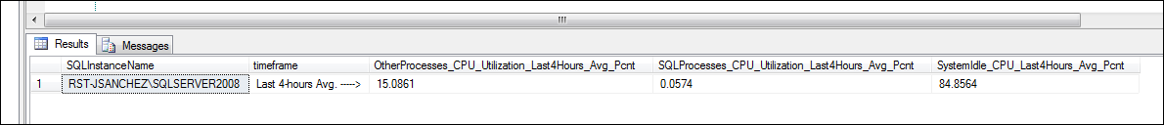
T-SQL for Determine if CPU Bottleneck
Avg. CPU Utilization on the Last 4-Hours
declare @ts_now bigint
select @ts_now = cpu_ticks / (cpu_ticks/ms_ticks) from sys.dm_os_sys_info
;with tbl
as
(
select
@@servername as SQLInstanceName
,dateadd(ms, -1 * (@ts_now - [timestamp]), GetDate()) as EventTime
,cast(SQLProcessUtilization as money) as SQLProcessUtilization_Pcnt
,cast((100 - SystemIdle - SQLProcessUtilization) as money) as OtherProcessUtilization_Pcnt
,cast(SystemIdle as money) as SystemIdle_Pcnt
from (
select
record.value('(./Record/@id)[1]', 'int') as record_id,
record.value('(./Record/SchedulerMonitorEvent/SystemHealth/SystemIdle)[1]', 'int') as SystemIdle,
record.value('(./Record/SchedulerMonitorEvent/SystemHealth/ProcessUtilization)[1]', 'int') as SQLProcessUtilization,
timestamp
from (
select timestamp, convert(xml, record) as record
from sys.dm_os_ring_buffers
where ring_buffer_type = N'RING_BUFFER_SCHEDULER_MONITOR'
and record like '%<SystemHealth>%'
) as x
) as y
)
select
SQLInstanceName,
'Last 4-hours Avg. ----->' as 'timeframe',
avg(OtherProcessUtilization_Pcnt) as OtherProcesses_CPU_Utilization_Last4Hours_Avg_Pcnt,
avg(SQLProcessUtilization_Pcnt) as SQLProcesses_CPU_Utilization_Last4Hours_Avg_Pcnt,
avg(SystemIdle_Pcnt) as SystemIdle_CPU_Last4Hours_Avg_Pcnt
from tbl
where datediff(mi,EventTime,getdate()) <= 241
group by SQLInstanceName

Slide 20
T-SQL for Determine if CPU Bottleneck
RULE #1… signal_waits > 25.0 % of total_waits
RULE #2… cxpacket wait_type > 10.0% of total_waits
select
convert(varchar,cast((sum(signal_wait_time_ms)*1.0
/ sum(wait_time_ms)*1.0)
*100 as money)) + ' %' as signal_waits_pcnt
from sys.dm_os_wait_stats
select
convert(varchar,cast(
( select sum(wait_time_ms) from sys.dm_os_wait_stats
where upper(wait_type) in('CXPACKET') ) * 1.0
/
( select sum(wait_time_ms) from sys.dm_os_wait_stats ) * 1.0
*100 as money)) + ' %' as cxpacket_total_wait_time_pcnt

Slide 21


T-SQL for Determine if CPU Bottleneck
RULE #1… signal_waits > 25.0 % of total_waits
RULE #2… cxpacket wait_type > 10.0% of total_waits
select
convert(varchar,cast((sum(signal_wait_time_ms)*1.0
/ sum(wait_time_ms)*1.0)
*100 as money)) + ' %' as signal_waits_pcnt
from sys.dm_os_wait_stats
select
convert(varchar,cast(
( select sum(wait_time_ms) from sys.dm_os_wait_stats
where upper(wait_type) in('CXPACKET') ) * 1.0
/
( select sum(wait_time_ms) from sys.dm_os_wait_stats ) * 1.0
*100 as money)) + ' %' as cxpacket_total_wait_time_pcnt

Slide 22
T-SQL for Determine Avg. Transactions Per Second
use [z_LoadTest]
declare @t1 as money = 0, @t2 as money = 0, @n1 as datetime, @n2 as datetime, @i int = 10000
if exists (select * from sysobjects where name like 'tblTest%') drop table tblTest
create table tblTest(
record_id int identity(1,1) primary key, first_name varchar(50), last_name varchar(50)
,date_record_added datetime default(getdate())
)
-- determine 1st time baseline...
select @t1 = cntr_value, @n1 = getdate() from sys.dm_os_performance_counters
where ltrim(rtrim(counter_name)) = 'Transactions/sec' and ltrim(rtrim(instance_name)) = db_name()
-- loop...
while @i > 0
begin
begin transaction
insert into tblTest(first_name,last_name) values('Fulano','de Tal')
set @i = @i - 1
commit transaction
end
-- determine 2nd time baseline...
select @t2 = cntr_value, @n2 = getdate()
from sys.dm_os_performance_counters
where ltrim(rtrim(counter_name)) = 'Transactions/sec' and ltrim(rtrim(instance_name)) = db_name()
select
case
when datediff(ss,@n1,@n2)<=0 then convert(varchar,0,22)
else convert(varchar, ( (@t2 - @t1)/datediff(ss,@n1,@n2) ),22)
end as 'avg_transactions_per_second'

Slide 23
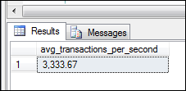
T-SQL for Determine Avg. Transactions Per Second
use [z_LoadTest]
declare @t1 as money = 0, @t2 as money = 0, @n1 as datetime, @n2 as datetime, @i int = 10000
if exists (select * from sysobjects where name like 'tblTest%') drop table tblTest
create table tblTest(
record_id int identity(1,1) primary key, first_name varchar(50), last_name varchar(50)
,date_record_added datetime default(getdate())
)
-- determine 1st time baseline...
select @t1 = cntr_value, @n1 = getdate() from sys.dm_os_performance_counters
where ltrim(rtrim(counter_name)) = 'Transactions/sec' and ltrim(rtrim(instance_name)) = db_name()
-- loop...
while @i > 0
begin
begin transaction
insert into tblTest(first_name,last_name) values('Fulano','de Tal')
set @i = @i - 1
commit transaction
end
-- determine 2nd time baseline...
select @t2 = cntr_value, @n2 = getdate()
from sys.dm_os_performance_counters
where ltrim(rtrim(counter_name)) = 'Transactions/sec' and ltrim(rtrim(instance_name)) = db_name()
select
case
when datediff(ss,@n1,@n2)<=0 then convert(varchar,0,22)
else convert(varchar, ( (@t2 - @t1)/datediff(ss,@n1,@n2) ),22)
end as 'avg_transactions_per_second'

Slide 24
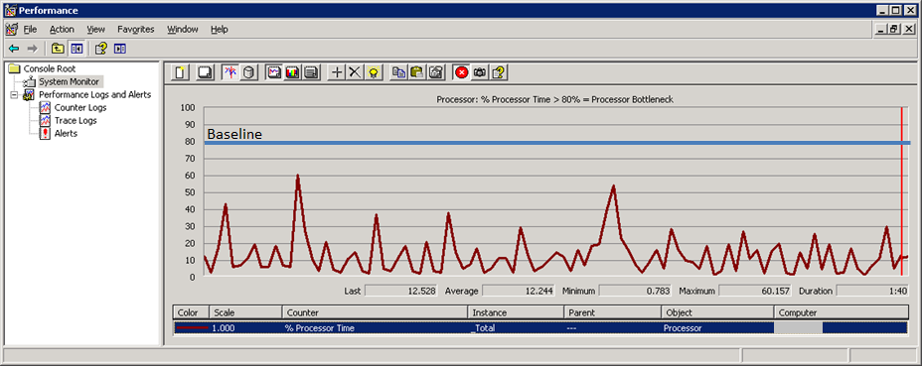
Windows Counter - Determine if CPU Bottleneck
Processor: % Processor Time > 80% = CPU Bottleneck
% Processor Time is the percentage of elapsed time that the processor spends to execute a non-Idle thread. It is calculated by measuring the percentage of time that the processor spends executing the idle thread and then subtracting that value from 100%. (Each processor has an idle thread that consumes cycles when no other threads are ready to run). This counter is the primary indicator of processor activity, and displays the average percentage of busy time observed during the sample interval. It should be noted that the accounting calculation of whether the processor is idle is performed at an internal sampling interval of the system clock (10ms). On todays fast processors, % Processor Time can therefore underestimate the processor utilization as the processor may be spending a lot of time servicing threads between the system clock sampling interval. Workload based timer applications are one example of applications which are more likely to be measured inaccurately as timers are signaled just after the sample is taken.

Slide 25
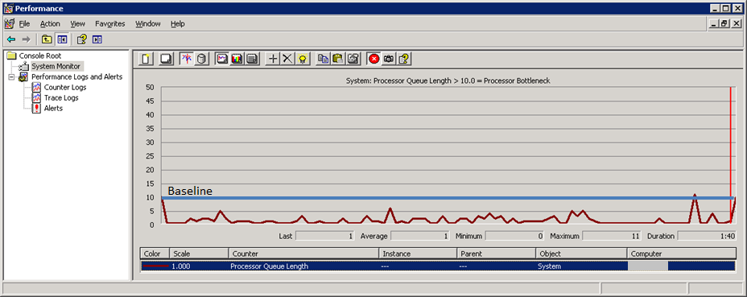
Windows Counter - Determine if CPU Bottleneck
System: Processor Queue Length > 10.0 = CPU Bottleneck
Processor Queue Length is the number of threads in the processor queue. Unlike the disk counters, this counter counters, this counter shows ready threads only, not threads that are running. There is a single queue for processor time even on computers with multiple processors. Therefore, if a computer has multiple processors, you need to divide this value by the number of processors servicing the workload. A sustained processor queue of less than 10 threads per processor is normally acceptable, dependent of the workload.

Slide 26
RAM Bottleneck

Slide 27
T-SQL for Determine if Memory RAM Bottleneck
RULE #1… Avg Page Life Expectancy < 300 sec (5 mins)
RULE #2… Buffer Cache Hit Ratio < 90.0%
select cntr_value as avg_page_life_expectancy
from sys.dm_os_performance_counters
where
ltrim(rtrim(counter_name)) = 'Page life expectancy'
and instance_name = ''
select
convert(varchar,cast( (
(select cntr_value *1.0 from sys.dm_os_performance_counters
where ltrim(rtrim(counter_name)) = 'Buffer cache hit ratio')
/
(select cntr_value *1.0 from sys.dm_os_performance_counters
where ltrim(rtrim(counter_name)) = 'Buffer cache hit ratio base')
) *100.0 as money)) + ' %' as buffer_cache_hit_ratio

Slide 28


T-SQL for Determine if Memory RAM Bottleneck
RULE #1… Avg Page Life Expectancy < 300 sec (5 mins)
RULE #2… Buffer Cache Hit Ratio < 90.0%
select cntr_value as avg_page_life_expectancy
from sys.dm_os_performance_counters
where
ltrim(rtrim(counter_name)) = 'Page life expectancy'
and instance_name = ''
select
convert(varchar,cast( (
(select cntr_value *1.0 from sys.dm_os_performance_counters
where ltrim(rtrim(counter_name)) = 'Buffer cache hit ratio')
/
(select cntr_value *1.0 from sys.dm_os_performance_counters
where ltrim(rtrim(counter_name)) = 'Buffer cache hit ratio base')
) *100.0 as money)) + ' %' as buffer_cache_hit_ratio

Slide 29
I/O Bottleneck

Slide 30
T-SQL for Determine if I/O Bottleneck
PAGEIOxxx waits %
select
convert(varchar,cast(
( select sum(wait_time_ms) from sys.dm_os_wait_stats
where upper(wait_type) like '%PAGEIO%' ) * 1.0
/
( select sum(wait_time_ms) from sys.dm_os_wait_stats ) * 1.0
*100 as money) ) + ' %' as total_io_wait_time_pcnt

Slide 31

T-SQL for Determine if I/O Bottleneck
PAGEIOxxx waits %
select
convert(varchar,cast(
( select sum(wait_time_ms) from sys.dm_os_wait_stats
where upper(wait_type) like '%PAGEIO%' ) * 1.0
/
( select sum(wait_time_ms) from sys.dm_os_wait_stats ) * 1.0
*100 as money) ) + ' %' as total_io_wait_time_pcnt

Slide 32
T-SQL for Determine Top Worst Files I/O
Top Worst Files I/O:
with dbio as
(
select
db_name(ivfs.database_id) as db
,ivfs.file_id
,mf.physical_name as file_name
,case
when mf.type = 1 then 'log'
else 'data'
end as file_type
,sum(ivfs.num_of_bytes_read + ivfs.num_of_bytes_written) as io
,sum(ivfs.io_stall) as io_stall
from sys.dm_io_virtual_file_stats(null, null) as ivfs
join sys.master_files as mf
on ivfs.database_id = mf.database_id
and ivfs.file_id = mf.file_id
group by db_name(ivfs.database_id)
,ivfs.file_id, mf.physical_name, mf.type
)
select
row_number() over(order by a.io_stall desc) as line_id
,a.db as database_name
,upper(a.file_type) as file_type
,(a.io_stall *1.0 / sum(a.io_stall) over()) *100 as io_stall_pct_of_100
,a.file_name
from dbio as a
order by a.io_stall desc

Slide 33
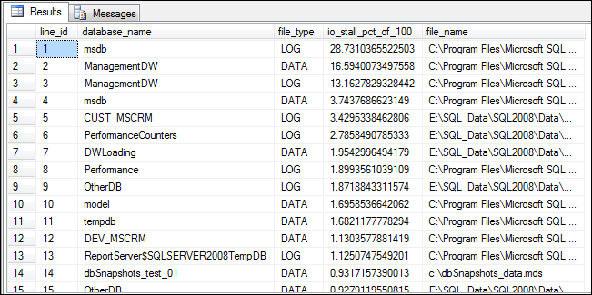
T-SQL for Determine Top Worst Files I/O
Top Worst Files I/O:
with dbio as
(
select
db_name(ivfs.database_id) as db
,ivfs.file_id
,mf.physical_name as file_name
,case
when mf.type = 1 then 'log'
else 'data'
end as file_type
,sum(ivfs.num_of_bytes_read + ivfs.num_of_bytes_written) as io
,sum(ivfs.io_stall) as io_stall
from sys.dm_io_virtual_file_stats(null, null) as ivfs
join sys.master_files as mf
on ivfs.database_id = mf.database_id
and ivfs.file_id = mf.file_id
group by db_name(ivfs.database_id)
,ivfs.file_id, mf.physical_name, mf.type
)
select
row_number() over(order by a.io_stall desc) as line_id
,a.db as database_name
,upper(a.file_type) as file_type
,(a.io_stall *1.0 / sum(a.io_stall) over()) *100 as io_stall_pct_of_100
,a.file_name
from dbio as a
order by a.io_stall desc

Slide 34
Waits

Slide 35
T-SQL for TOP Waits
Top Waits
with waits as
(
select
wait_type
,wait_time_ms / 1000. as wait_time_s
,100.0 * wait_time_ms / sum(wait_time_ms) over() as pct
,row_number() over(order by wait_time_ms desc) as rn
from sys.dm_os_wait_stats
-- filter out additional irrelevant waits
where
upper(wait_type) not like '%SLEEP%'
)
select
w1.wait_type
,convert(varchar,cast(w1.wait_time_s as money),100) + ' secs' as total_wait_time_sec
,convert(varchar,cast(w1.pct as money),100) + ' %' as wait_time_pcnt
,convert(varchar,cast(sum(w2.pct) as money),100) + ' %' as accumulative_pcnt
from
waits as w1
inner join waits as w2 on w2.rn <= w1.rn
group by w1.rn, w1.wait_type, w1.wait_time_s, w1.pct
having sum(w2.pct) - w1.pct <= 90 -- percentage threshold
order by w1.rn

Slide 36
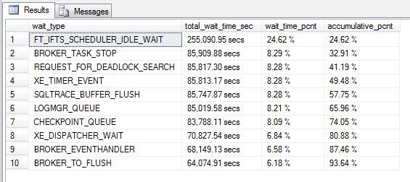
T-SQL for TOP Waits
Top Waits
with waits as
(
select
wait_type
,wait_time_ms / 1000. as wait_time_s
,100.0 * wait_time_ms / sum(wait_time_ms) over() as pct
,row_number() over(order by wait_time_ms desc) as rn
from sys.dm_os_wait_stats
-- filter out additional irrelevant waits
where
upper(wait_type) not like '%SLEEP%'
)
select
w1.wait_type
,convert(varchar,cast(w1.wait_time_s as money),100) + ' secs' as total_wait_time_sec
,convert(varchar,cast(w1.pct as money),100) + ' %' as wait_time_pcnt
,convert(varchar,cast(sum(w2.pct) as money),100) + ' %' as accumulative_pcnt
from
waits as w1
inner join waits as w2 on w2.rn <= w1.rn
group by w1.rn, w1.wait_type, w1.wait_time_s, w1.pct
having sum(w2.pct) - w1.pct <= 90 -- percentage threshold
order by w1.rn

Slide 37
Sessions Blocked

Slide 38
T-SQL for See Sessions Blocked, by Who, and in which Database
Sessions Blocked and by Who
To present the last command:
To destroy the connection:
To present who much time needs to finish destroying:
exec sp_who2
DBCC INPUTBUFFER (spid_number)
KILL spid_number
KILL spid_number WITH STATUSONLY

Slide 39
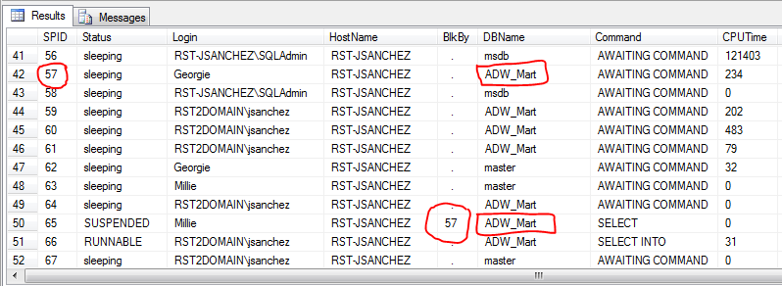
T-SQL for See Sessions Blocked, by Who, and in which Database
Sessions Blocked and by Who
To present the last command:
To destroy the connection:
To present who much time needs to finish destroying:
exec sp_who2
DBCC INPUTBUFFER (spid_number)
KILL spid_number
KILL spid_number WITH STATUSONLY

Slide 40

T-SQL for See Sessions Blocked, by Who, and in which Database
Sessions Blocked and by Who
To present the last command:
To destroy the connection:
To present who much time needs to finish destroying:
exec sp_who2
DBCC INPUTBUFFER (spid_number)
KILL spid_number
KILL spid_number WITH STATUSONLY

Slide 41
T-SQL for See Sessions Blocked, by Who, and in which Database
Sessions Blocked and by Who
To present the last command:
To destroy the connection:
To present who much time needs to finish destroying:
exec sp_who2
DBCC INPUTBUFFER (spid_number)
KILL spid_number
KILL spid_number WITH STATUSONLY

Slide 42
Tables blocked

Slide 43
T-SQL for Tables with Exclusive Locks
Tables with Exclusive Locks:
select
object_name(resource_associated_entity_id) as table_name
,case request_mode
when 'S' then 'Shared (S)'
when 'X' then 'Exclusive (X)'
when 'IS' then 'Intent Shared (IS)'
when 'SIX' then 'Shared with intent exclusive (SIX)'
when 'IX' then 'Intent Exclusive (IX)'
when 'U' then 'Update (U)'
when 'Sch-M' then 'Schema'
when 'BU' then 'Bulk Update (BU)'
else request_mode
end as request_mode_desc
,request_type
,request_status
,case
when request_mode = 'X'
and upper(request_status) = 'GRANT'
then 'Bad Guy (Blocker) -->'
else ''
end as note
,request_session_id as spid
,request_reference_count
,request_owner_type
from sys.dm_tran_locks
where
resource_database_id = db_id()
and resource_type in('object')

Slide 44

T-SQL for Tables with Exclusive Locks
Tables with Exclusive Locks:
select
object_name(resource_associated_entity_id) as table_name
,case request_mode
when 'S' then 'Shared (S)'
when 'X' then 'Exclusive (X)'
when 'IS' then 'Intent Shared (IS)'
when 'SIX' then 'Shared with intent exclusive (SIX)'
when 'IX' then 'Intent Exclusive (IX)'
when 'U' then 'Update (U)'
when 'Sch-M' then 'Schema'
when 'BU' then 'Bulk Update (BU)'
else request_mode
end as request_mode_desc
,request_type
,request_status
,case
when request_mode = 'X'
and upper(request_status) = 'GRANT'
then 'Bad Guy (Blocker) -->'
else ''
end as note
,request_session_id as spid
,request_reference_count
,request_owner_type
from sys.dm_tran_locks
where
resource_database_id = db_id()
and resource_type in('object')

Slide 45
Statistics

Slide 46
T-SQL for Determine Statistics to be Updated
Statistics to be Updated:
select
schemas.name as table_schema
,tbls.name as table_name
,i.name as index_name
,stats_date( i.id, i.indid ) as lastStatsUpdate
from
sysindexes i
inner join sysobjects tbls on i.id = tbls.id
inner join sysusers schemas on tbls.uid = schemas.uid
inner join INFORMATION_SCHEMA.TABLES tl
on tbls.name = tl.table_name
and schemas.name = tl.table_schema
and upper(tl.table_type) = 'BASE TABLE'
where
0 < i.indid
and i.indid < 255
and lower(table_schema) <> 'sys'
and i.rowmodctr <> 0
and (select max(rowcnt)
from sysindexes i2
where i.id = i2.id and i2.indid < 2
) > 0

Slide 47
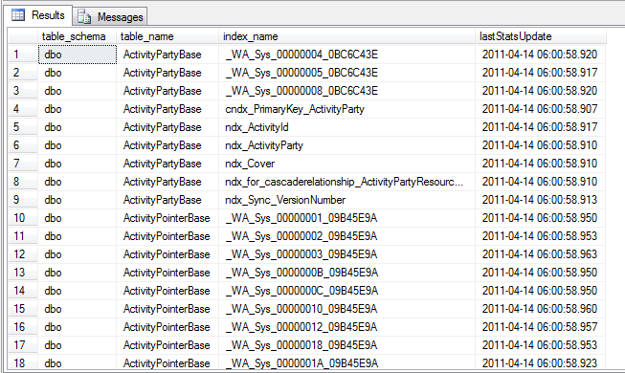
T-SQL for Determine Statistics to be Updated
Statistics to be Updated:
select
schemas.name as table_schema
,tbls.name as table_name
,i.name as index_name
,stats_date( i.id, i.indid ) as lastStatsUpdate
from
sysindexes i
inner join sysobjects tbls on i.id = tbls.id
inner join sysusers schemas on tbls.uid = schemas.uid
inner join INFORMATION_SCHEMA.TABLES tl
on tbls.name = tl.table_name
and schemas.name = tl.table_schema
and upper(tl.table_type) = 'BASE TABLE'
where
0 < i.indid
and i.indid < 255
and lower(table_schema) <> 'sys'
and i.rowmodctr <> 0
and (select max(rowcnt)
from sysindexes i2
where i.id = i2.id and i2.indid < 2
) > 0

Slide 48
T-SQL for Determine Statistics to be Updated
Statistics to be Updated:
select
schemas.name as table_schema
,tbls.name as table_name
,i.name as index_name
,stats_date( i.id, i.indid ) as lastStatsUpdate
from
sysindexes i
inner join sysobjects tbls on i.id = tbls.id
inner join sysusers schemas on tbls.uid = schemas.uid
inner join INFORMATION_SCHEMA.TABLES tl
on tbls.name = tl.table_name
and schemas.name = tl.table_schema
and upper(tl.table_type) = 'BASE TABLE'
where
0 < i.indid
and i.indid < 255
and lower(table_schema) <> 'sys'
and i.rowmodctr <> 0
and (select max(rowcnt)
from sysindexes i2
where i.id = i2.id and i2.indid < 2
) > 0
USE [database_name_here]
GO
EXEC SP_UPDATESTATS
GO

Slide 49
Ad hoc Query Plans

Slide 50
T-SQL for Determine if Ad-hoc Queries are Predominant
select
case objtype
when 'Proc' then 'Stored procedures'
when 'Prepared' then 'Prepared statements'
when 'Adhoc' then 'Ad hoc queries'
when 'ReplProc' then 'Replication-filter-procedures'
when 'Trigger' then 'Triggers'
when 'View' then 'Views'
when 'Default' then 'Defaults'
when 'UsrTab' then 'User tables'
when 'SysTab' then 'System tables'
when 'Check' then 'CHECK constraints'
when 'Rule' then 'Rules'
end as cache_type
,sum( (case when usecounts = 1 then 1 else 0 end) )
as unique_query_plans
,count_big(*) as total_query_plans
,convert(varchar,cast ( sum((case when usecounts = 1 then 1 else 0 end)) * 1.0
/ count_big(*) as money) *100) + ' %' as unique_query_plans_pcnt
,cast( sum( (case when usecounts = 1 then size_in_bytes else 0 end) )
/1048576.0 as money) as unique_query_plans_mb
,cast(sum(size_in_bytes * 1.0)/1048576.0 as money)
as total_query_plans_mb
,convert(varchar,cast(sum((case when usecounts=1 then size_in_bytes else 0 end))/1048576.0 as money)
/
cast(sum(size_in_bytes * 1.0)/1048576.0 as money)
*100) + ' %' as unique_query_plans_mb_pcnt
from sys.dm_exec_cached_plans
group by objtype
order by
cast(sum((case when usecounts = 1 then size_in_bytes else 0 end) )/1048576.0 as money) desc

Slide 51
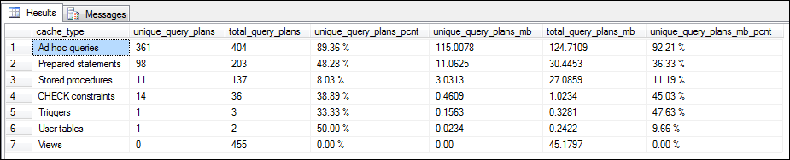
T-SQL for Determine if Ad-hoc Queries are Predominant
select
case objtype
when 'Proc' then 'Stored procedures'
when 'Prepared' then 'Prepared statements'
when 'Adhoc' then 'Ad hoc queries'
when 'ReplProc' then 'Replication-filter-procedures'
when 'Trigger' then 'Triggers'
when 'View' then 'Views'
when 'Default' then 'Defaults'
when 'UsrTab' then 'User tables'
when 'SysTab' then 'System tables'
when 'Check' then 'CHECK constraints'
when 'Rule' then 'Rules'
end as cache_type
,sum( (case when usecounts = 1 then 1 else 0 end) )
as unique_query_plans
,count_big(*) as total_query_plans
,convert(varchar,cast ( sum((case when usecounts = 1 then 1 else 0 end)) * 1.0
/ count_big(*) as money) *100) + ' %' as unique_query_plans_pcnt
,cast( sum( (case when usecounts = 1 then size_in_bytes else 0 end) )
/1048576.0 as money) as unique_query_plans_mb
,cast(sum(size_in_bytes * 1.0)/1048576.0 as money)
as total_query_plans_mb
,convert(varchar,cast(sum((case when usecounts=1 then size_in_bytes else 0 end))/1048576.0 as money)
/
cast(sum(size_in_bytes * 1.0)/1048576.0 as money)
*100) + ' %' as unique_query_plans_mb_pcnt
from sys.dm_exec_cached_plans
group by objtype
order by
cast(sum((case when usecounts = 1 then size_in_bytes else 0 end) )/1048576.0 as money) desc
DBCC FREEPROCCACHE
-- if the instance is SQL2008 or higher...
EXECUTE sys.sp_configure 'optimize for ad hoc workloads',N'1'
RECONFIGURE WITH OVERRIDE

Slide 52
Triggers

Slide 53
TRIGGERS with Rollback Transaction or other Commands
Look for triggers in the database.
Specially for those that has ROLLBACK TRANSACTION.
Verify if the trigger does a process that it may be taken from the trigger and run as a separate process (maybe as a SQL Job).
select
object_name(parent_object_id) as table_name
,obj.name as trigger_name
,case
when (select patindex ('%AFTER%',upper(mod.definition))) > 0 then 'AFTER TRIGGER'
when (select patindex ('%INSTEAD%',upper(mod.definition))) > 0 then 'INSTEAD OF TRIGGER'
else 'AFTER TRIGGER'
end as trigger_type
,case
when (select patindex ('%ROLLBACK%',upper(mod.definition))) > 0 then 'YES'
else 'NO'
end as rollback_transaction
,mod.definition as trigger_code
from sys.all_objects as obj
left join sys.sql_modules mod
on mod.object_id = obj.object_id
where upper(obj.type) in('TR')
order by object_name(parent_object_id),obj.name

Slide 54
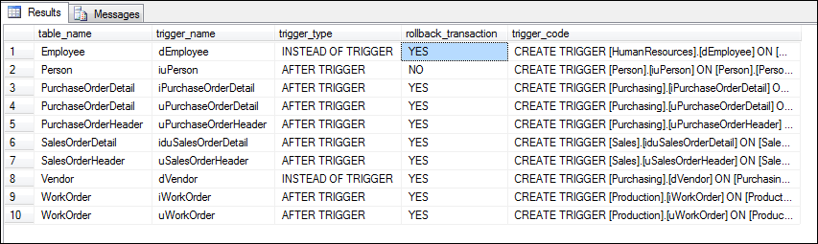
TRIGGERS with Rollback Transaction or other Commands
Look for triggers in the database.
Specially for those that has ROLLBACK TRANSACTION.
Verify if the trigger does a process that it may be taken from the trigger and run as a separate process (maybe as a SQL Job).
select
object_name(parent_object_id) as table_name
,obj.name as trigger_name
,case
when (select patindex ('%AFTER%',upper(mod.definition))) > 0 then 'AFTER TRIGGER'
when (select patindex ('%INSTEAD%',upper(mod.definition))) > 0 then 'INSTEAD OF TRIGGER'
else 'AFTER TRIGGER'
end as trigger_type
,case
when (select patindex ('%ROLLBACK%',upper(mod.definition))) > 0 then 'YES'
else 'NO'
end as rollback_transaction
,mod.definition as trigger_code
from sys.all_objects as obj
left join sys.sql_modules mod
on mod.object_id = obj.object_id
where upper(obj.type) in('TR')
order by object_name(parent_object_id),obj.name

Slide 55
SQL Trace

Slide 56
SQL TRACE vs. SQL Profiler
DON’T RUN SQL Profiler in the server.
Then what?
Run SQL Profiler in your computer.
Connect to the server.
Indicate the events and columns wanted.
Filter by the database to be evaluated.
Run the trace for 1 second, then stop it.
Export the trace as script.
Optimize the script.
And then and only then, run the SQL Trace Script in the server.
And to evaluate?
Use the fn_trace_gettable() function to query the content of the SQL Trace file(s).
You can use the SQL Trace file(s) with SQL Server – Database Engine Tuning Advisor to evaluate for the creation of new indexes.

Slide 57
DBA Maintenance

Slide 58
DBA Maintenance – UPDATE/DELETE Records
When needed to UPDATE or DELETE records, always use syntax designed for Very Large Databases (VLD).
DON’T USE…
Instead, use the following:
delete from PerformanceCounters.dbo.tblCPU
where EventTime < getdate()
declare @today datetime
set @today = convert(varchar,getdate(),1)
while exists(
select top 1 RecordID
from PerformanceCounters.dbo.tblCPU
where EventTime < @today
)
begin
delete top (1000) from PerformanceCounters.dbo.tblCPU
where EventTime < @today
end

Slide 59
DBA Maintenance – Recreating/Defragging INDEXES
When needed to Recreate or Defrag INDEXES, always use syntax designed for Very Large Databases (VLD).
DON’T USE…
Instead, use the following:
ALTER INDEX [idx_PerformanceCounters_tblCPU]
ON [PerformanceCounters].[dbo].[tblCPU]
REORGANIZE
-- In OLTP systems…
ALTER INDEX [idx_PerformanceCounters_tblCPU]
ON [PerformanceCounters].[dbo].[tblCPU]
REBUILD WITH (MAXDOP = 1, SORT_IN_TEMPDB = ON)
-- In OLAP (Data Warehouse) systems, specially in FACT TABLES…
ALTER INDEX [idx_PerformanceCounters_tblCPU]
ON [PerformanceCounters].[dbo].[tblCPU]
REBUILD WITH (MAXDOP = 1, SORT_IN_TEMPDB = ON, DATA_COMPRESSION = PAGE)

Slide 60
DBA Maintenance – CURSORS
When needed to use iterations, always use LOOPS instead of CURSORS. If not possible, then use FORWARD_ONLY CURSORS.
declare @db_id int, @db_name sysname
set @db_id = 0
set @db_name = ''
-- look for the first record...
select @db_id = min(database_id) from sys.databases
option (maxdop 1)
-- loop...
while @db_id is not null
begin
-- task to be done...
select @db_name = name from sys.databases where database_id = @db_id
option (maxdop 1)
print @db_name
-- look for the next record...
select @db_id = min(database_id) from sys.databases where database_id > @db_id
option (maxdop 1)
end
Loop sample without
using cursor

Slide 61
Windows Performance Counters
Run Windows Performance Monitor and create performance counters for the following:
To Evaluate PROCESSOR Pressure:
Processor: % Processor Time
Processor: % Processor Time (Every CPU Core)
Process: % Processor Time (sqlservr)
Processor: % Privilege Time
Processor: % User Time
System: Processor Queue Length
Processor: Interrupts/sec
System: System Calls/sec
System: Context Switches/sec

Slide 62
Windows Performance Counters
Run Windows Performance Monitor and create performance counters for the following:
To Evaluate MEMORY Pressure
SQLServer: Buffer Manager: Buffer cache hit ratio
SQLServer: Buffer Manager: Page life expectancy
SQLServer: Buffer Manager: Checkpoint pages/sec
Memory: Pages/sec
SQLServer: Buffer Manager: Free pages
SQLServer: Buffer Manager: Page reads/sec
SQLServer: Buffer Manager: Page writes/sec
SQLServer: Buffer Manager: Reserved pages
SQLServer: Buffer Manager: Stolen pages
SQLServer: Memory Manager: Memory Grants Pending
SQLServer: Memory Manager: Target Server Memory (KB)
SQLServer: Memory Manager: Total Server Memory (KB)
SQLServer: SQL Statistics: SQL Compilations/sec
SQLServer: SQL Statistics: SQL Re-Compilations/sec
Paging File: % Usage
SQLServer: General Statistics: User Connections

Slide 63
Windows Performance Counters
Run Windows Performance Monitor and create performance counters for the following:
NOTE:
Use the RELOG Windows Utility to transfer the data from the Windows performance log into a SQL Server database. It requires an ODBC configuration.
http://technet.microsoft.com/en-us/library/cc773076(WS.10).aspx
To Evaluate I/O Pressure
PhysicalDisk: Avg. Disk Queue Length
PhysicalDisk: Avg. Disk Sec/Read
PhysicalDisk: Avg. Disk Sec/Write

Slide 64
Web Links
Microsoft SQL Server Customer Advisory Team (SQL CAT)
http://sqlcat.com/
Troubleshooting SQL Server 2005/2008 Performance and Scalability Flowchart
http://sqlcat.com/sqlcat/b/presentations/archive/2008/04/18/troubleshooting-sql-server-2005-2008-performance-and-scalability-flowchart.aspx
Fast Track: improving performance through correct LUN Mapping and Storage Enclosure configuration
http://sqlcat.com/sqlcat/b/msdnmirror/archive/2012/05/03/fast-track-improving-performance-through-correct-lun-mapping-and-storage-enclosure-configuration.aspx
A Technical Case Study: Fast and Reliable Backup and Restore of Multi-Terabytes Database over the Network
http://sqlcat.com/sqlcat/b/whitepapers/archive/2009/08/13/a-technical-case-study-fast-and-reliable-backup-and-restore-of-a-vldb-over-the-network.aspx
Diagnosing and Troubleshooting SQL Server Performance Problems
http://support.microsoft.com/kb/982870
Troubleshooting Performance Problems in SQL Server 2008
http://sqlcat.com/sqlcat/b/whitepapers/archive/2009/04/14/troubleshooting-performance-problems-in-sql-server-2008.aspx
Download CPUz
http://www.cpuid.com/softwares/cpu-z.html
Download Intel® Processor Identification Utility
http://www.intel.com/support/processors/tools/piu/sb/CS-014921.htm
Download Intel® Processor Diagnostic Tool
http://www.intel.com/support/processors/sb/CS-031726.htm
Paul S. Randal (Ex-Microsoft SQL Server team member, SQL Server Certified Master, DBCC developer)
http://www.sqlskills.com/blogs/paul/
Kimberly L. Tripp (Ex-Microsoft SQL Server team member, SQL Server Certified Master, Indexes specialist)
http://www.sqlskills.com/blogs/kimberly/
Brent Ozar (Ex-Quest member, SQL Server Certified Master, Performance & Storage Specialist)
http://www.brentozar.com

Slide 65
Web Links
SQL Server 2008 Microsoft Certified Master (MCM) Readiness Videos
http://technet.microsoft.com/en-us/sqlserver/ff977043.aspx
HP - Configuring HP Proliant BIOS for Low-Latency
http://h20000.www2.hp.com/bc/docs/support/SupportManual/c01804533/c01804533.pdf
DELL - Configuring Low-Latency Environments on Dell PowerEdge 12th Generation Servers
http://en.community.dell.com/techcenter/extras/m/white_papers/20100533/download.aspx
DELL - Configuring Low-Latency Environments on Dell PowerEdges Servers
http://www.dell.com/downloads/global/products/pedge/en/configuring_dell_powerEdge_servers_for_low_latency_12132010_final.pdf

Slide 66
Thank You
Jorge Sánchez SQL Server Consultant, Rock Solid Technologies jsanchez@rocksolid.com
Work: (787) 235-0773, Personal: (787) 487-2977
http://rocksolid.com
http://www.linkedin.com/in/jorgesanchezpr

Slide 67
















Platinum Sponsors:
Gold Sponsors:
Silver Sponsors:
Bronze Sponsors:
Swag Sponsors:

